Slide 1

Smart Innovation Smart Solution

Slide 2
About Us
Founded in 2021, Prayash Engineering specializes in mechanical fabrication, material handling equipment, industrial pipelines, and the supply and maintenance of equipment spares. Led by Nilesh Patel, who brings more than 18 years of experience, the company delivers complete engineering solutions and is certified with ISO 9001:2015.

Slide 3
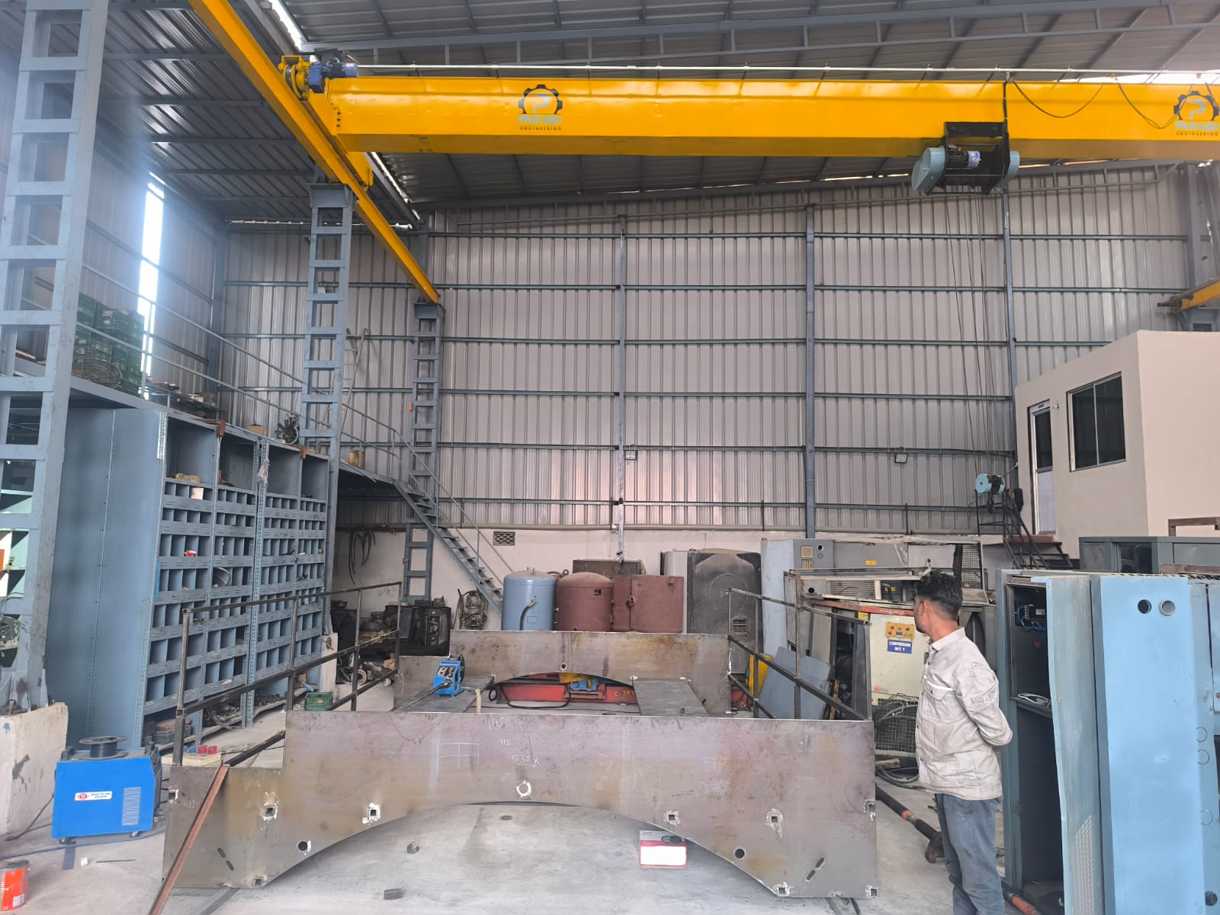
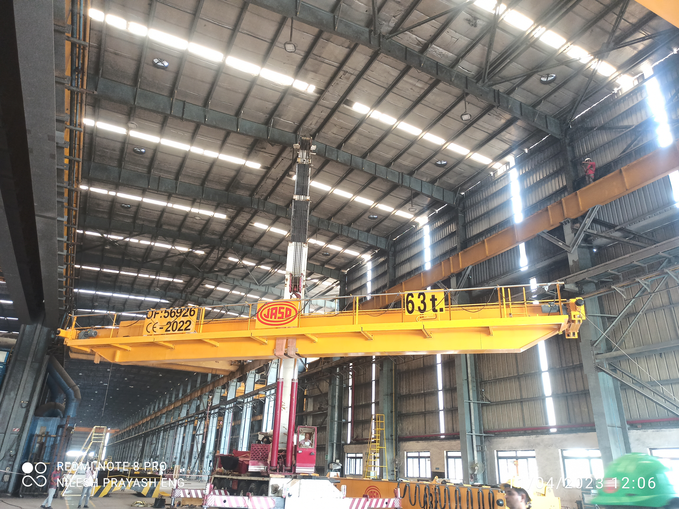
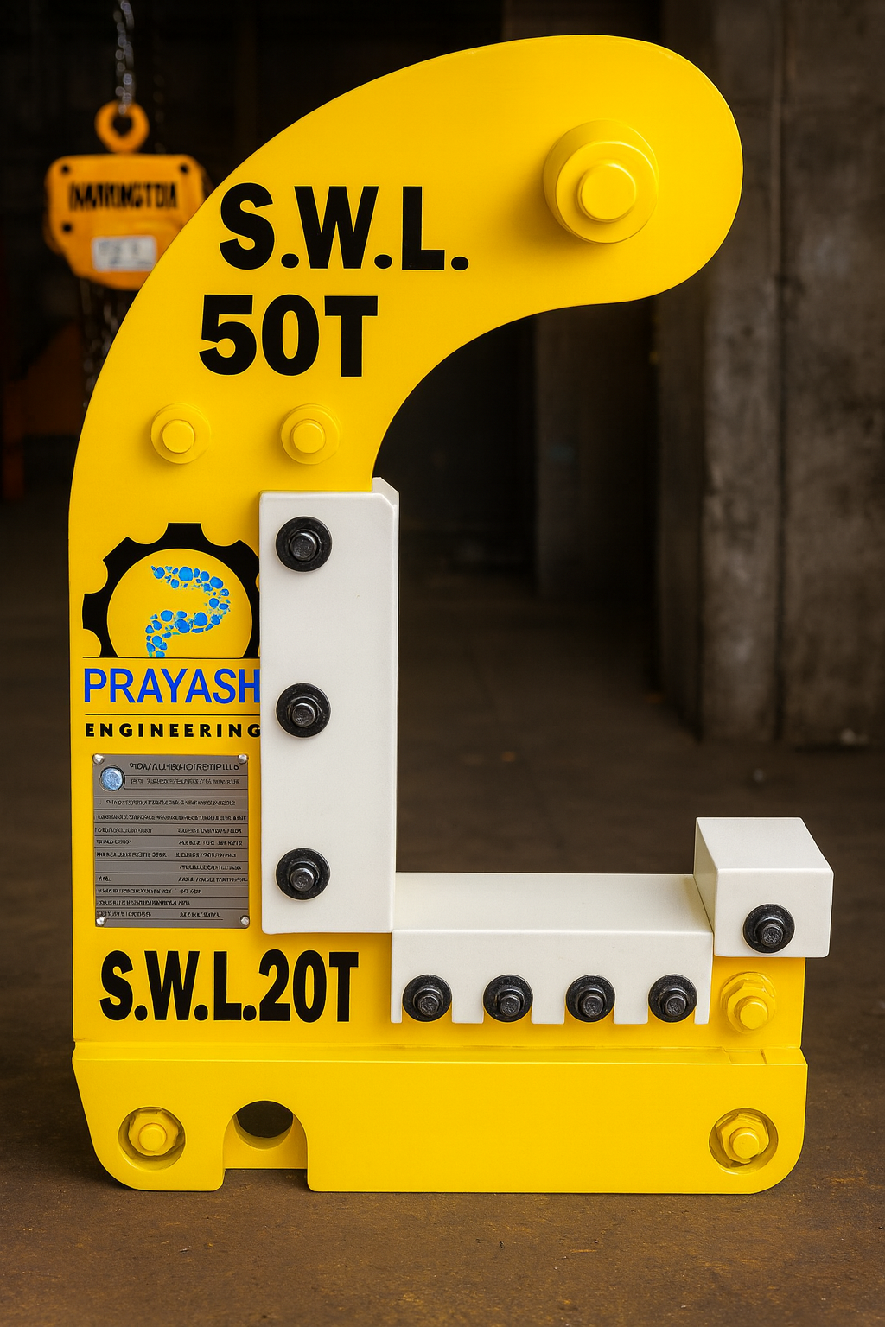
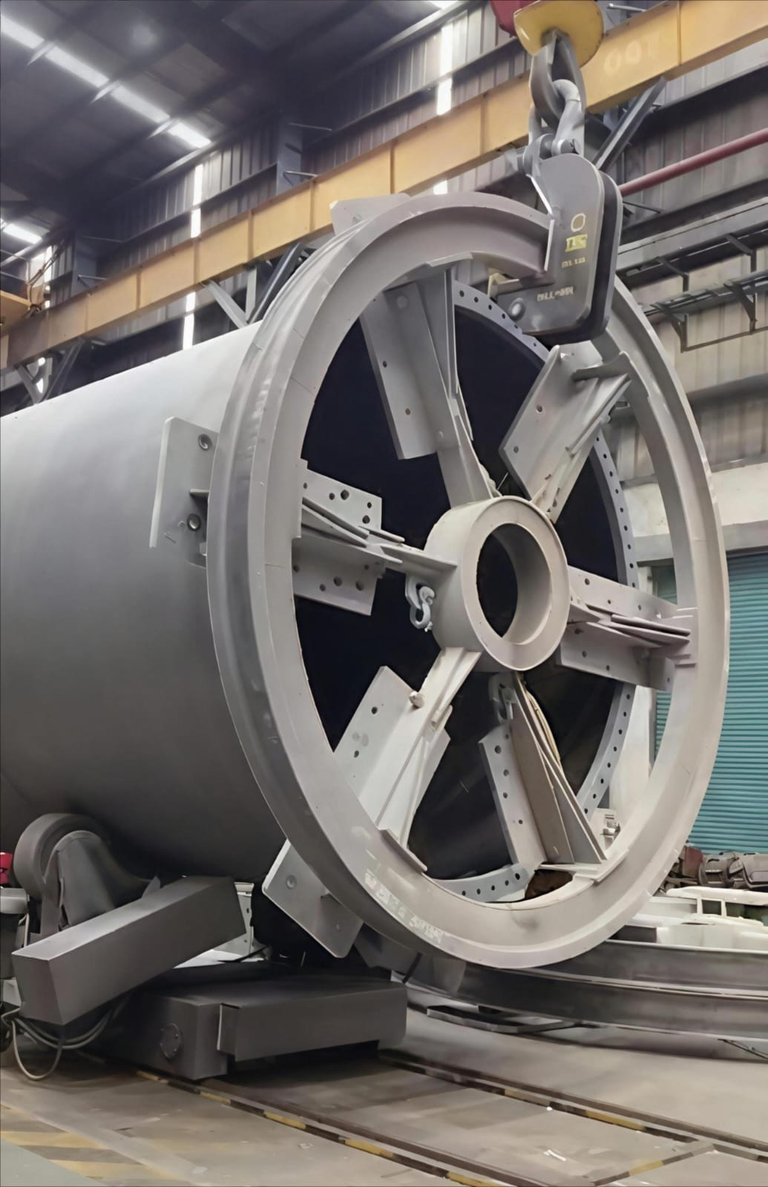
Heavy Lifting Equipment Solutions
• Eot Crane, Windmill tower hooks, spreader beams Etc.

Slide 4
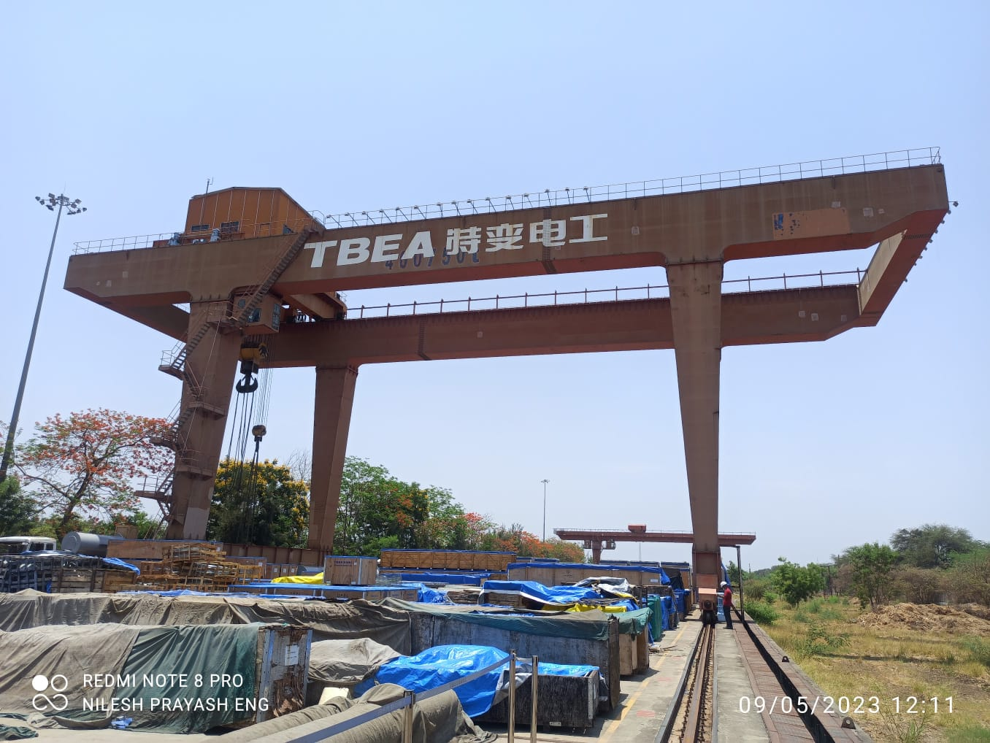
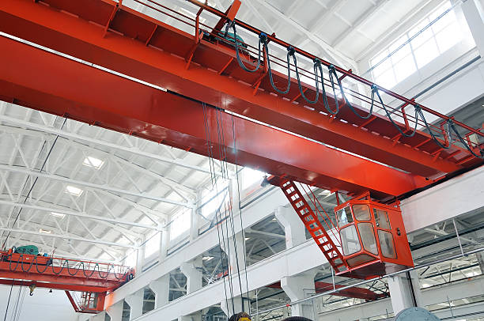
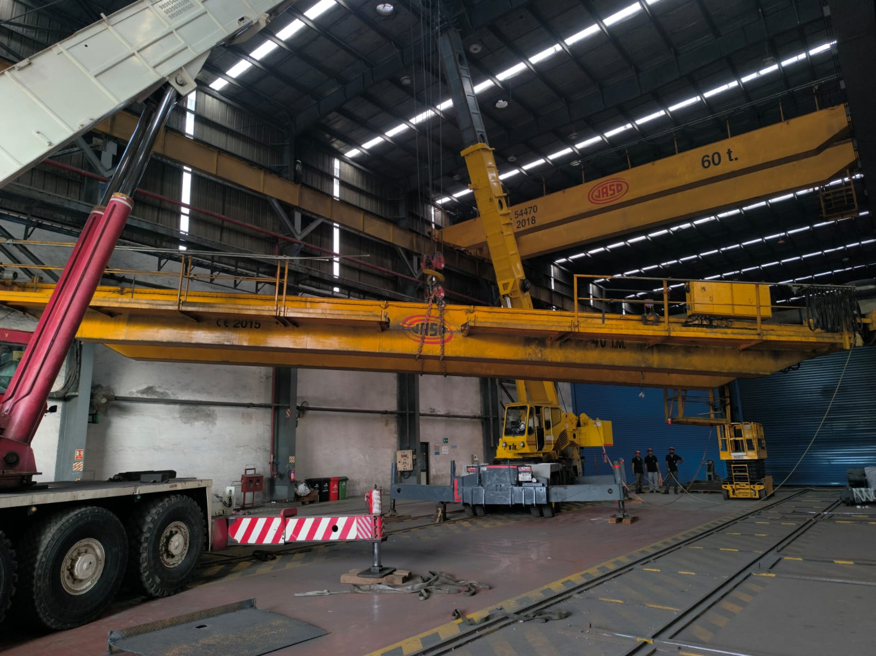
EOT & Gantry Crane Spares and Service
• Repair and preventive maintenance
• Safety inspections and capacity upgrades

Slide 5
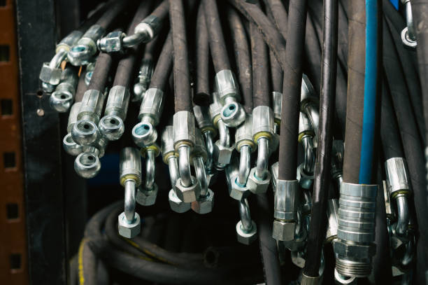
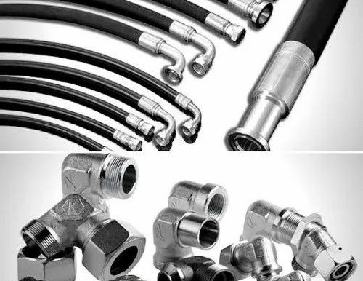
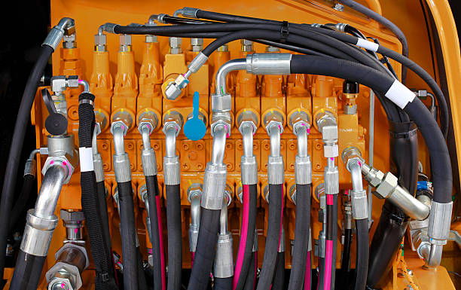
Hydraulic Hose Pipes & Fittings
• Hose assemblies and fitting solutions
• Pressure-rated components and safety compliance

Slide 6
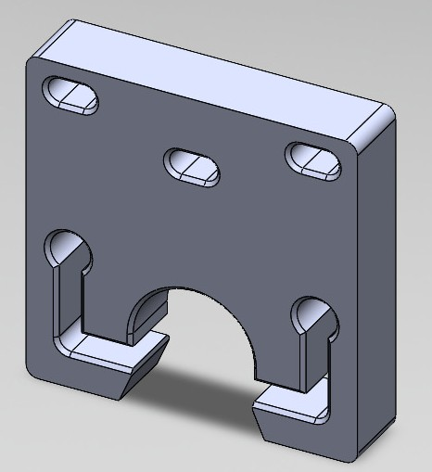
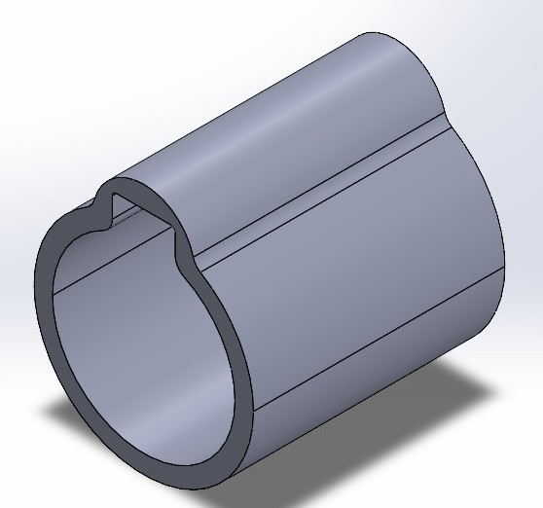
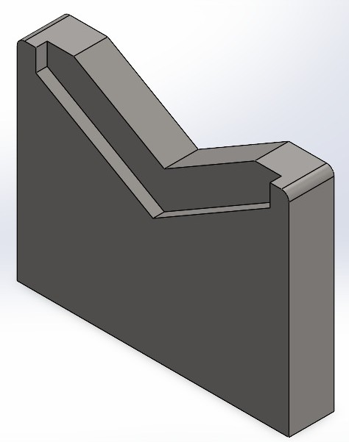
High-Precision Engineering Services
• CNC machining, welding, alignment
• Tight tolerance manufacturing
• QA inspections with dial gauges and CMMs

Slide 7
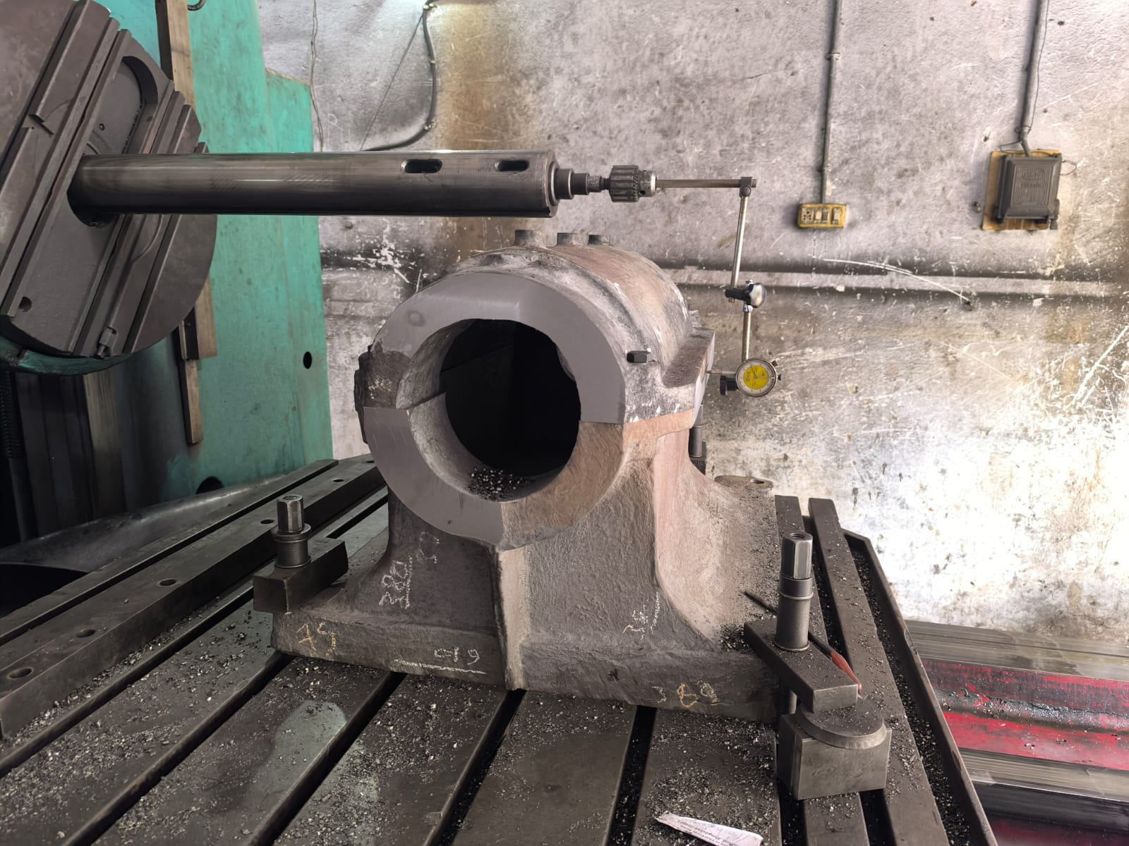
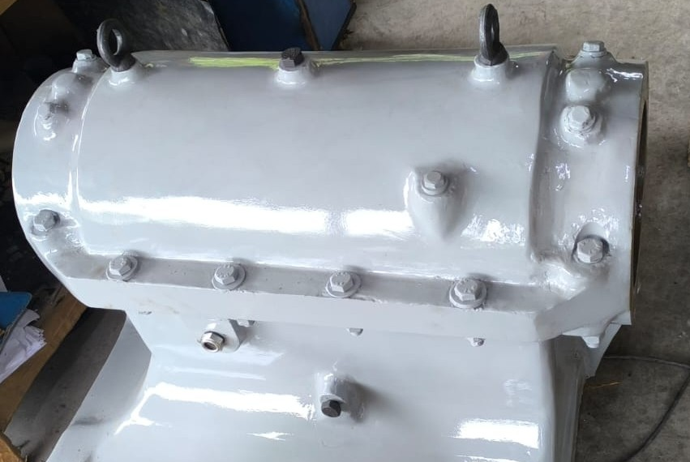
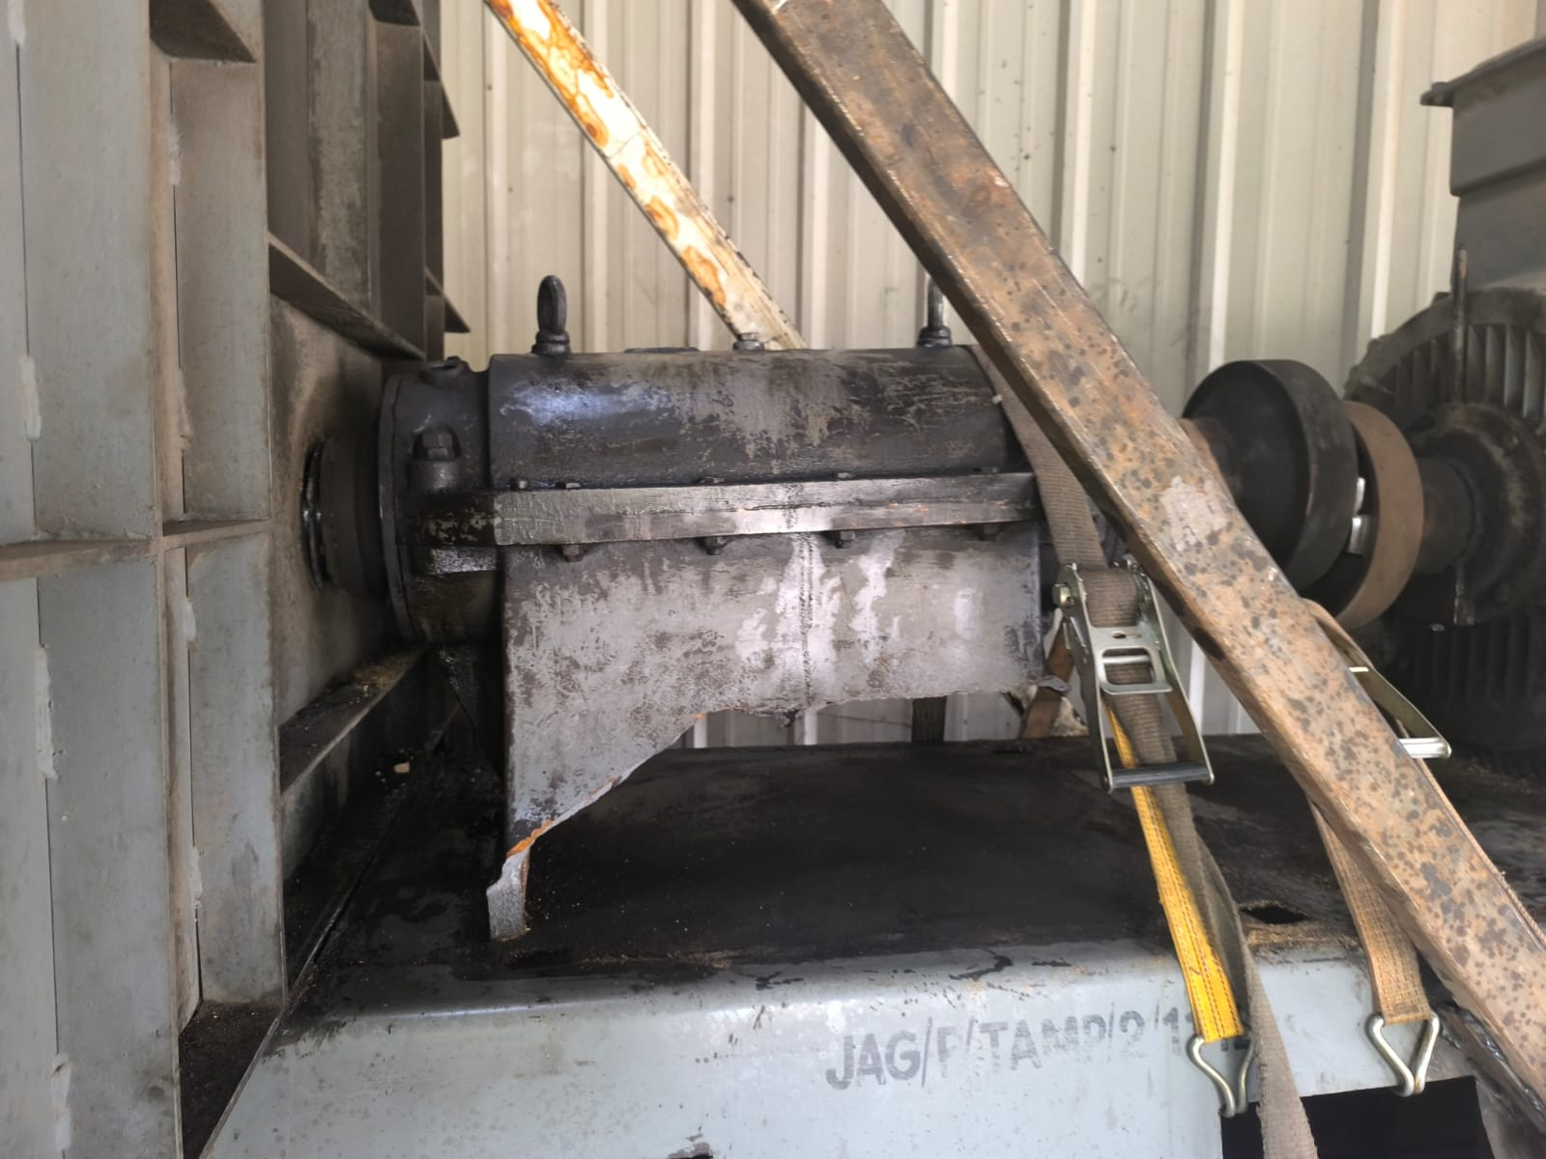
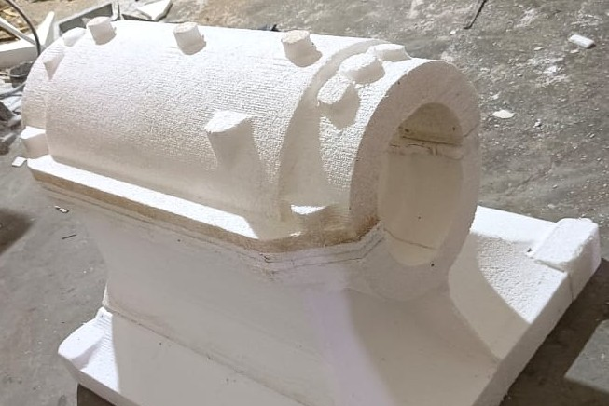
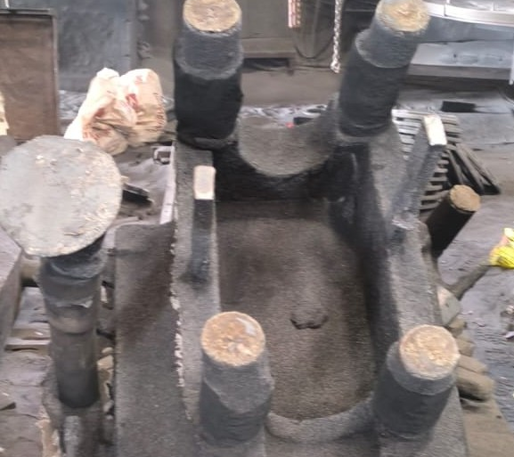
Development of Rare/Imported Machinery Parts
• Reverse engineering of obsolete components
• Import substitution with enhanced materials
• Custom solutions for unique machinery

Slide 8
From Blueprint to Beast
• CAD models and 3D simulations
• Robust finished hardware
• Complete design-to-delivery execution

Slide 9
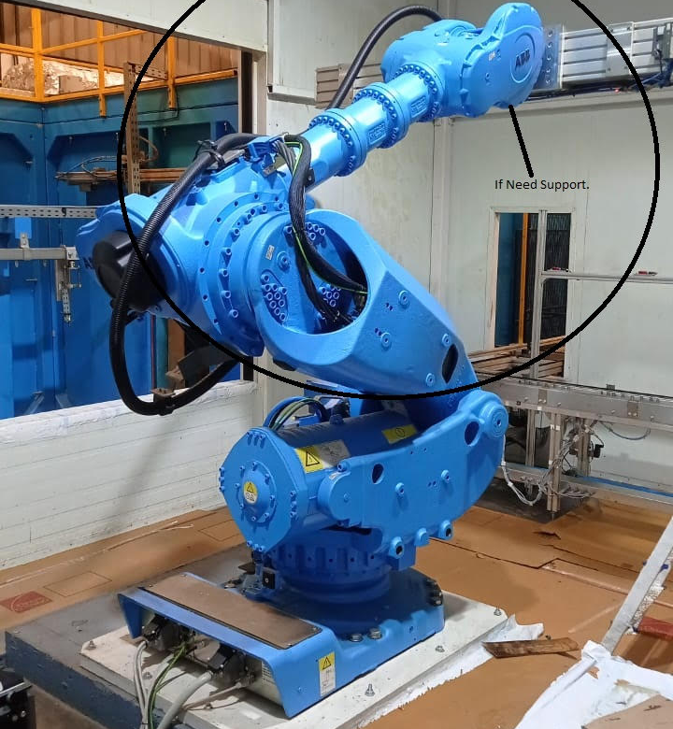
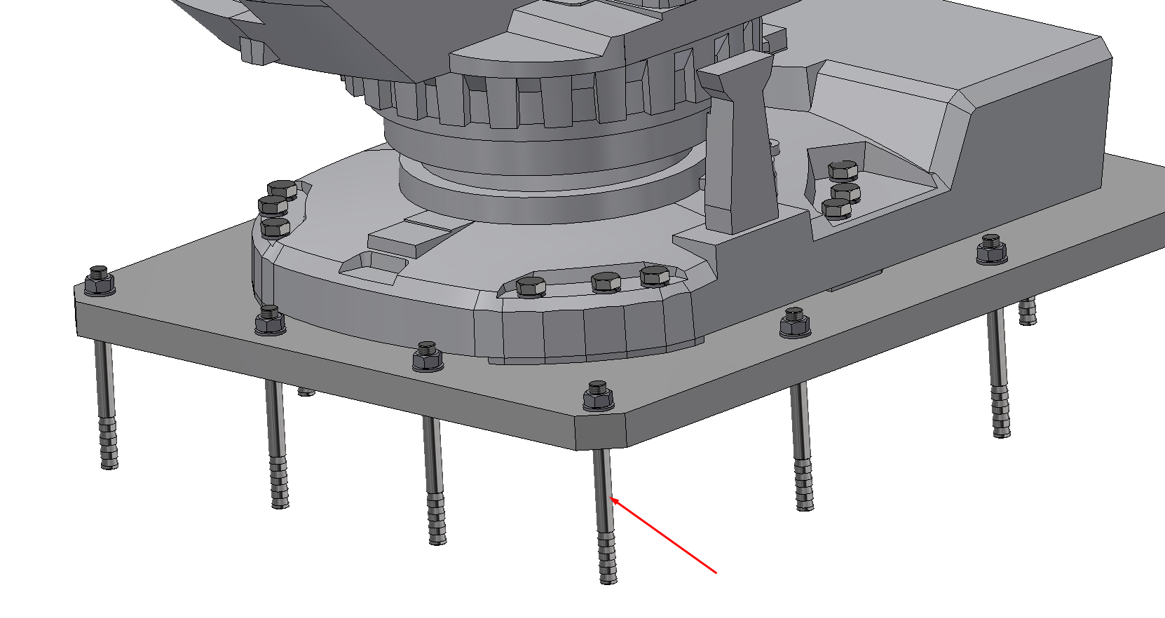
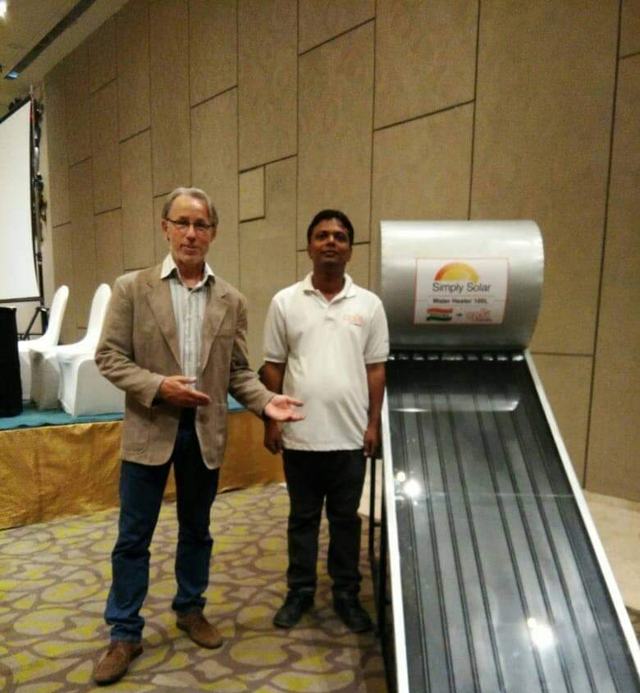
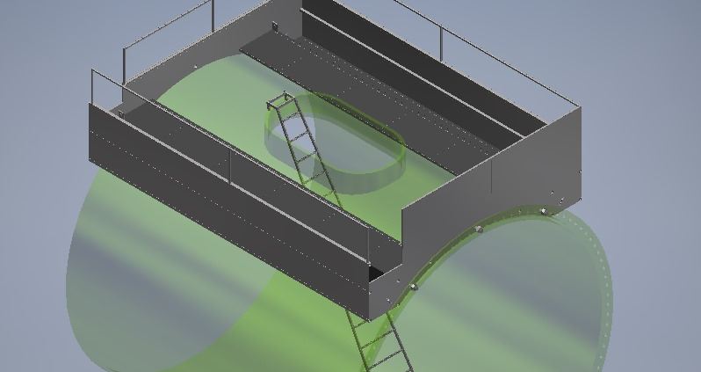
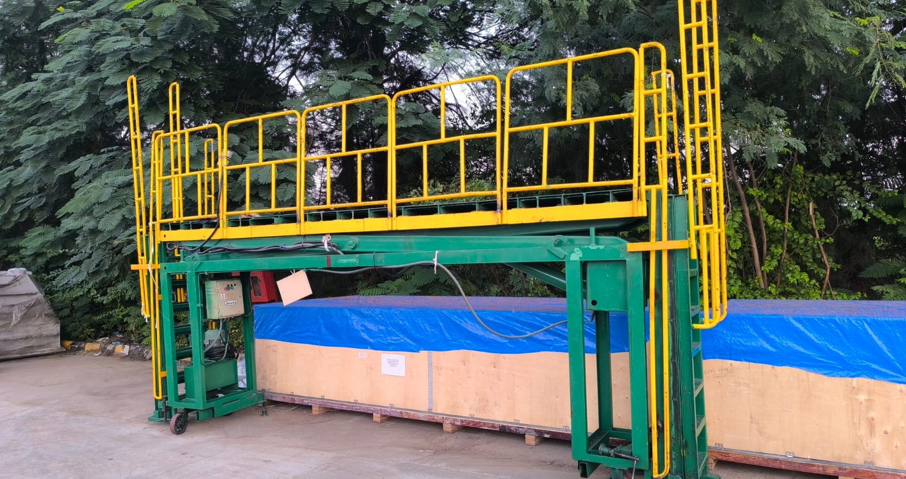
Other Developed Equipment

Slide 10












Our Esteemed Clients

Slide 11
Contact Us
Nilesh Patel
302, Narayan Nagar, Opp. Velvet Cinema, Halol GIDC Road, Halol – 389350, Gujarat
Phone: +91 84017 59383
+91 96240 67712
Email: info@prayashengineering.com
www.prayashengineering.com
GST: 24AZZPP6123H2ZV MSME: UDYAM-GJ-14-0007427

